Slide 1
The Relational Model
COMP1204: Data Management

Slide 2


Slide 3
Larry Ellison
Founder, CTO, former CEO
of Oracle, Inc.

Slide 4


Slide 5
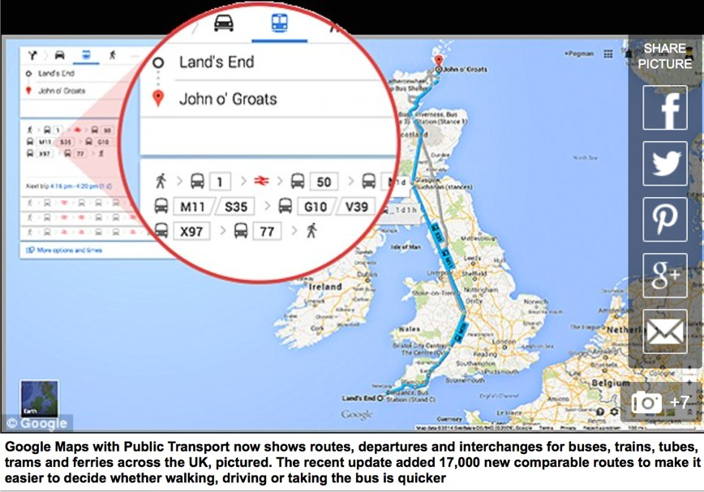

Slide 6
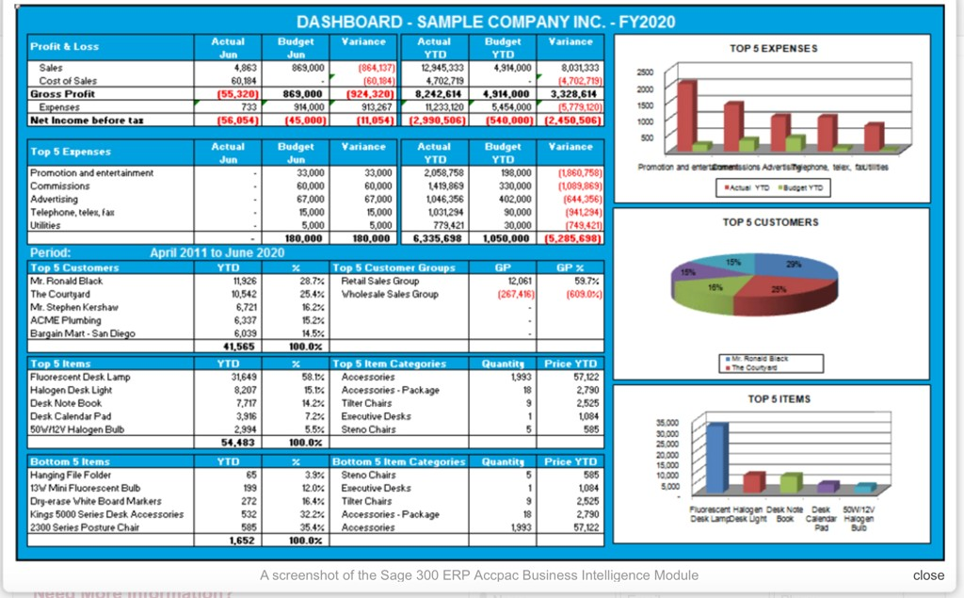

Slide 7
Database Systems
Powerful tools for creating and managing large amounts of data efficiently and allowing it to persist over long periods of time.
Database: a collection of data organised in a particular way and managed by a DBMS.
DBMS: Database Management System – a collection of software programs that manage a database

Slide 8
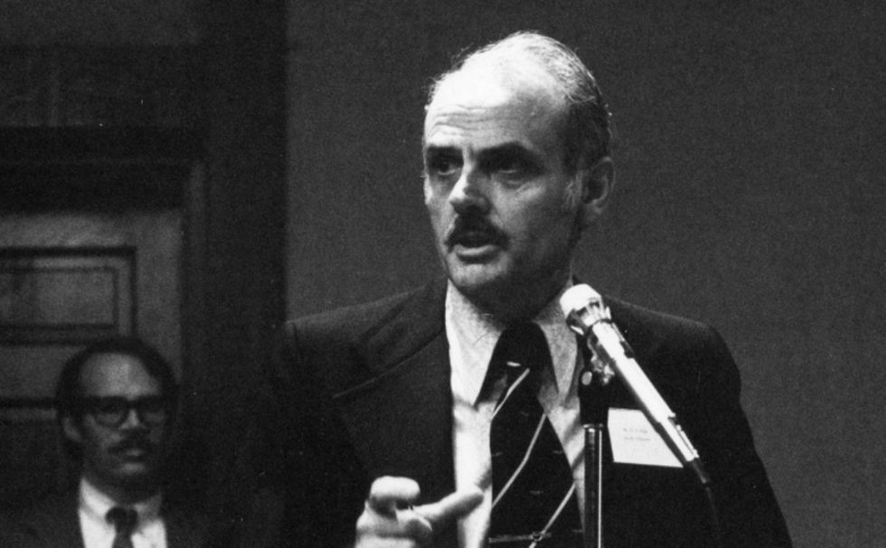
Database Systems A brief history
1970: Ted Codd, a British scientist working at IBM published “A relational model of data for large shared data banks”
IBM starts System R project:
the first implementation of a relational DBMS
In 1974-1975, they develop SEQUEL query language → SQL
System R evolved to DB2 – released in 1983
In the 70s UC Berkeley researchers start developing Ingres, commercialize it in 1983 → PostgreSQL
1979: Larry Ellison founds a company later known as Oracle
Oracle V2 is released in 1979 and Oracle V3 in 1983
1981: Ted Codd receives the ACM Turing Award
In 2015 database technologies’ revenue is $35.9B (Gartner, Inc.)

Slide 9
Database Technologies
Relational:
Proprietary: DB2, Oracle, HP
Open-Source: MySQL, Postgresql, SQLite
Non-Relational:
MongoDB, NoSQL
Parallel Frameworks: Hadoop/HiveQL

Slide 10







Application Application Application
DBMS
DISK/Database

Slide 11
Data Independence
Applications and users (should be) insulated from how data is structured and stored
Logical independence: Protection from changes in logical structure of data (i.e., attributes/schema)
Physical independence: Protection from changes in physical structure of data (i.e. how it is stored)
Q: Why is this particularly important for DBMS?
A: Because databases and their applications persist
Contrast with File-based storage (e.g., csv)

Slide 12
DBMS
A DBMS is a set of computer programs that support:
at least one data model (a mathematical abstraction for representing data) to define a database and an associated high-level language to create, manage and query the database
ability to store and manage large amounts of persistent data (as opposed to transient data), conveniently and efficiently
transaction management, concurrency control
access control (limit access of certain data to certain users)
resiliency (ability to recover from crashes)
DBMS ≠ File Systems

Slide 13
Data Model
A collection of (mathematical) concepts for describing data – how it is represented, organized and structured in the database
The relational model of data is the most widely used model today
Every data model has to come with a data language
for defining, updating, manipulating, and retrieving data from its representation

Slide 14
Data Sublanguages
A data language has two parts (sublanguages):
Data definition language (DDL)
syntax for describing “database templates” in terms of the underlying data model
Data manipulation language (DML):
for insertion, deletion, update, retrieval/extraction/querying
there is much variety in query languages

Slide 15
XML and Tree-structured Data XML as a Data Model
Breakfast
Data Definition Language for XML:
XML Schema
Data Manipulation Language for XML:
XPath/XQuery
Drink
Food
Name
Desc. Price
Name
T ype Price

Slide 16
Relational Data Model
Formalism for describing and representing data: relation (the mathematical concept)
Formally, a relation is a subset of a cartesian product of sets
Informally, a relation can be seen as a table
Students
Depts
ID | Name | DeptID
.. | ..
ID | Dept
.. | ..
Courses
Course | DeptID | Name
.. | .. | ..

Slide 17
Relations as subsets of cartesian products of sets
Set S₁ (student IDs)
Set S₂ (student Name)
68943
Mary
94433
×
John
=
78215
William
…
…

Slide 18
Relations as subsets of cartesian products of sets
Set S₁ (student IDs)
Set S₂ (student Name)
S₁ × S₂ =
68943
Mary
94433
×
John
=
68943,Mary
78215
William
68943,John
…
…
68943,William
94433,Mary
94433,Jonn
94433,William
78215,Mary
78215,John
78215,William
…

Slide 19
Relations as subsets of cartesian products of sets
Set S₁ (student IDs)
Set S₂ (student Name)
S₁ × S₂ =
68943
Mary
94433
×
John
=
68943,Mary
78215
William
68943,John
…
…
68943,William
94433,Mary
Students ⊆ S₁ × S₂
94433,Jonn
ID | Name
68943 | William
94433 | John
78215 | Mary
94433,William
78215,Mary
78215,John
78215,William
…

Slide 20
Relations as subsets of cartesian products of sets
Set S₁ (student IDs)
Set S₂ (student Name)
S₁ × S₂ =
68943
Mary
94433
×
John
=
68943,Mary
78215
William
68943,John
…
…
68943,William
94433,Mary
Students ⊆ S₁ × S₂
94433,Jonn
ID | Name
68943 | William
94433 | John
78215 | Mary
94433,William
78215,Mary
tuple
78215,John
78215,William
…

Slide 21
Basic Notions from Discrete Mathematics
A k-tuple is an ordered sequence of k objects (need not be distinct)
(2,0,1) is a 3-tuple; (a,b,a,a,c) is a 5-tuple, and so on
If D₁, D₂, …, D_{k} are k sets, then the cartesian product D₁ × D₂ … × D_{k} of these sets is the set of all k-tuples (d₁,d₂, …,d_{k}) such that d_{i} ∈ D_{i}, for 1 ≤ i ≤ k
Fact: Let |D| denote the cardinality (= # of elements, or size) of a set D. Then |D₁ × D₂ × … × D_{k}| = |D₁|× |D₂| × …× |D_{k}|
Example: If D₁ = {0,1} and D₂ ={a,b,c,d}, then |D₁|×|D₂| = 8
Warning: Computing cartesian products is an expensive operation!

Slide 22
Basic Notions from Discrete Mathematics
A k-ary relation R is a subset of a cartesian product of k sets, i.e., R ⊆ D₁× D₂× … × D_{k}
k is called the arity of the relation
Examples:
Unary: R = {0,2,4,…,100} (R ⊆ D)
Binary: T = {(a,b): a and b have the same birthday}
Ternary: S = {(m,n,s): s = m+n}
…

Slide 23
Tuples and attributes
R ⊆ D₁× D₂× … × D_{k} is a set of k-tuples and can be seen as a table with k columns
In the relational data model, we want to have names for the columns; these are the attributes of the relation
Students
In the relation Students,
attributes are: ID, Name, DeptID
ID | Name | DeptID
68943 | William | ECS
94433 | John | ECS

Slide 24
Attributes and Tuples
Students(ID, Name,DeptID)
{(123,Robert,ECS), (222,JohnDoe,EEE)}
Courses(CourseID, Name, DeptID)
{(COMP1204,DataM,ECS)}
Depts(ID, Name)
{(ECS,Electronics and Computer Science)}
StudentCourses(StudentID,CourseID)
{(123,COMP1204)}

Slide 25
Properties of Relations
A relation R(A₁,…A_{k}) has the following properties
Each row represents a k-tuple of R
The ordering of rows is immaterial (relations are just sets)
All rows are distinct (relations are just sets)
The ordering of the attributes is not significant
The significance of each column is conveyed by the name we give it
There are alternative definitions of relations that do or do not assume the attributes are ordered

Slide 26
Relation Schemas and Relational Database Schemas
A k-ary relation schema R(A₁,A₂,…,A_{K}) is relation name and an ordered sequence (A₁,A₂,…,A_{k}) of k attributes
StudentCourses(studentID, courseID)
Student(ID, name)
Courses(ID, name, DeptID)
A k-ary relation schema is a “blueprint”, a “template” for some k-ary relation
In a DBMS implementation the schema gives a more precise definition of the types (i.e., attribute domain)
StudentCourses(int: studentID, int: courseID)
Student(int: ID, string: name)
Courses(int: ID, string: name, string: DeptID)

Slide 27
Relation Schemas and Relational Database Schemas
An instance of a relation schema is a relation conforming to the schema (arities match; also, in DBMS, data types of attributes match)
A relational database schema is a set of relation schemas R_{i}(A₁,A₂,…,A_{ki}), for 1≤ i≤ m.
A relational database instance, or a database of a relational schema is a set of relations R_{i} each of which is an instance of the relation schema R_{i}, 1≤ i≤ m

Slide 28
Relational Intension vs Extension
Keep in mind that there is a clear distinction between
relation schemas and instances of relation schemas and between
relational database schemas and relational database instances
Intension changes infrequently - Extension is very dynamic. Why?
Intension | Extension
Relation Schema | Instance of a relation schema
Relational Database Schema | Relational Database Instance (i.e., database)

Slide 29
Keys
A set of attributes forms a key for a relation if we do not allow two different tuples in a relation instance to have the same values in all the attributes of the key
Courses(CourseID, Name, DeptID)
Students(Name,Surname)
i.e., name AND surname

Slide 30
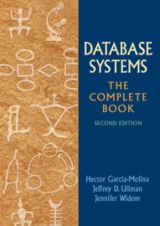
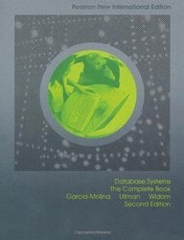
What you’ve learnt today
Importance of Databases and Database management systems
The Relational Model: properties of relations, intension/extension
Database Systems, the complete book. Garcia- Molina, Ullman, Widom

